Slide 1

IINSPIRE STEM Program Survey
sdmay25-24
Notes:
Alex – Hello everyone! We are excited to share our work this semester on the LSAMP IINSPIRE Program survey web application. Let's meet our team...

Slide 2
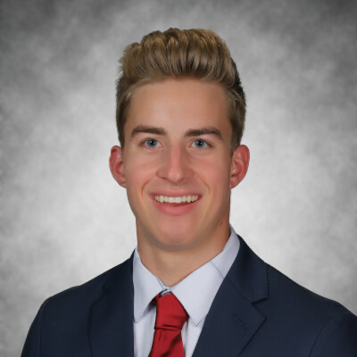



Team Introductions
Alex Moeller
Management
Matthew Bennett
Cloud/Infra
Landon Gulotta
Cloud/Infra
Nick Pinnello
Backend
Notes:
All – Intro yourself

Slide 3

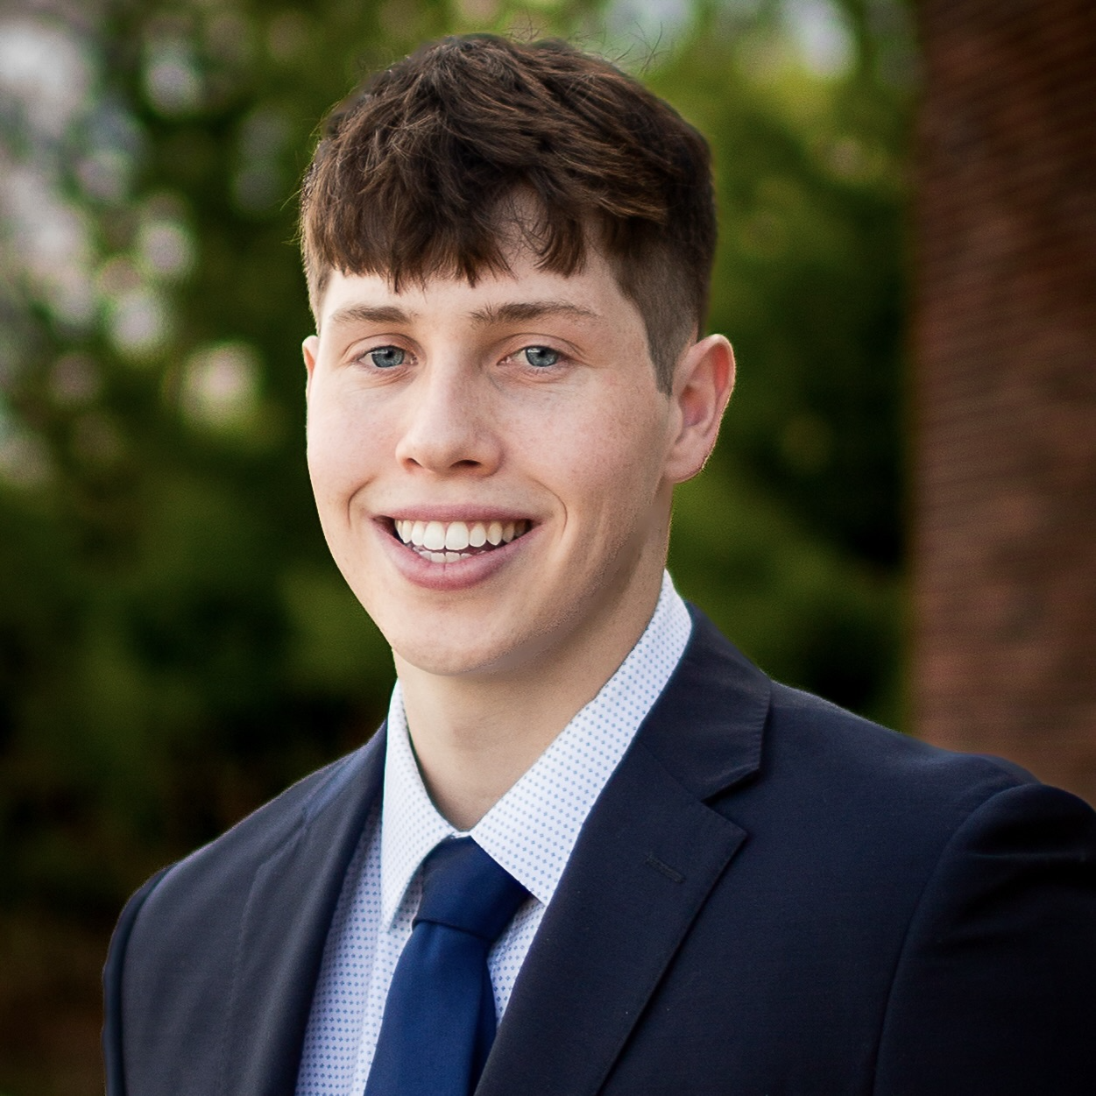

Team Introductions
Isabelle Raghavan
Frontend
Charlie Moreland
Backend
Max Strater
Frontend
Notes:
All – intro yourself

Slide 4
Agenda
High Level Overview of Project
Problem Statement
Previous Team's Progress (Prototype, Architecture, Functionality)
Requirements from Previous Design
User Requirements
Overview of New Design
Frontend Design
Backend Design
Cloud Design
Project Plan
Project Schedule
Final Summary
Notes:
Alex – We will start by reviewing important background information about our project, including last year's Senior Design team's work and important user requirements/use case. This will lead into our overall problem statement. Then we will discuss our project's features, including in-depth overviews of our frontend, backend, and cloud architectures. Finally, we will talk more about our plan for next semester and a brief conclusion.

Slide 5
Project Overview
National Science Foundation program
Surveys/programs across many large Universities
Goal: Help students visualize their growth over time:
Community Engagement
STEM Interest
STEM Self-Efficacy
STEM Career Expectations
Research Self-Efficacy
Research Outcome Expectations
Notes:
Alex – So, what is the INSPIRE LSAMP program? The IINSPIRE program is National Science Foundation platform designed to gauge the experience of undergrad STEM researchers. This program spans many Universities across Iowa, including the University of Iowa and Iowa State. The goal for this program is to help students understand their personal growth in 6 different areas: Community Engagement, STEM Interest, STEM Self-efficacy, STEM Career Expectations, Research Self-Efficacy, and Research Outcome Expectations. These 6 areas are vital for students to understand where they fall and what areas they may need to give more attention to throughout their college career. These six values can also help program coordinators understand where their program may need additional resources, or could even be used as data for

Slide 6
Problem Statement
Visualize STEM growth
Engage with survey data
Participate in STEM activities
Choose a career path
Notes:
Landon:
Our goal for our project is to help students visualize their growth throughout their participation in the program and to use this information to make informed decisions about their future.
We want to encourage students to actively engage with the survey data by showing students what areas they need to improve in and providing them with the tools to improve. We also want to motivate students to participate in STEM activities in order to improve their understanding of STEM majors and research. Finally, we hope to support students in making informed decisions about academic and career pathways based on their assessment and research experiences

Slide 7
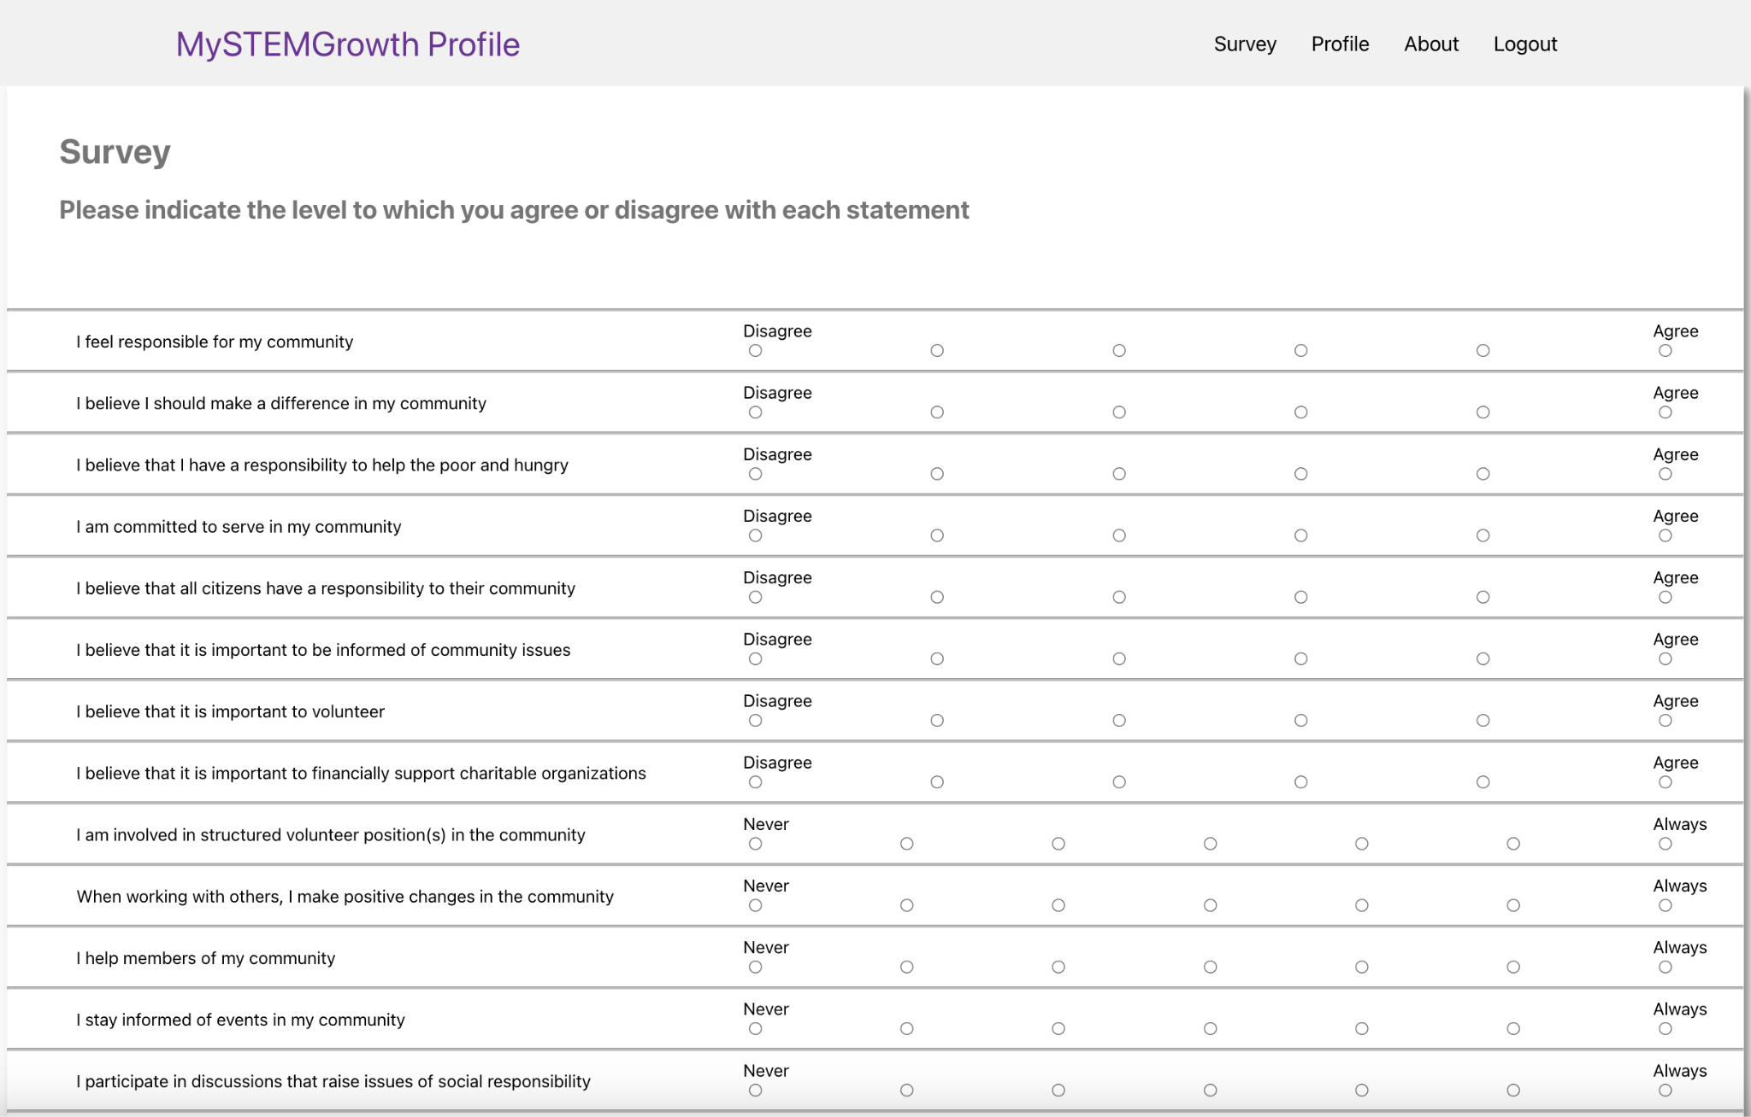
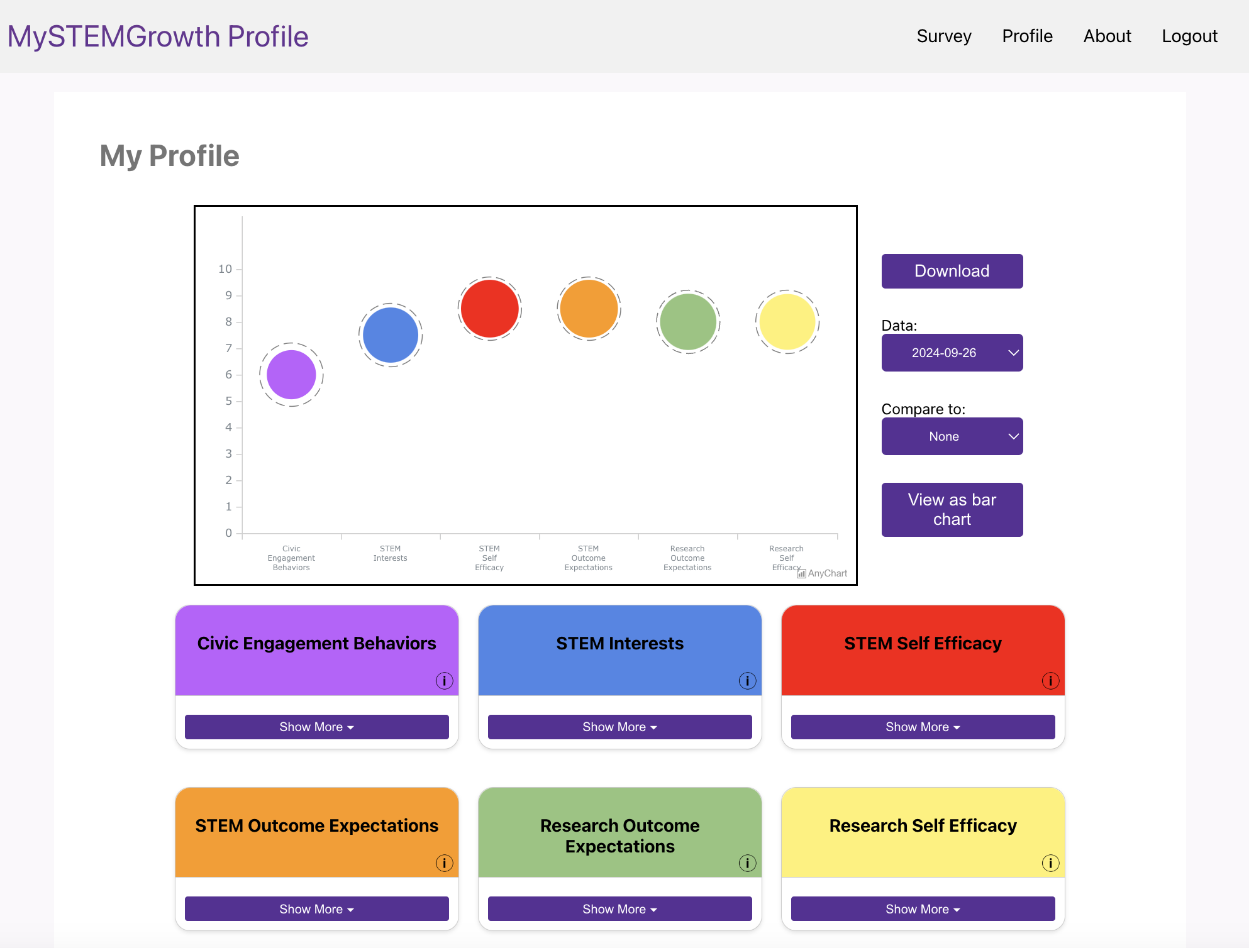
Previous team's progress - Prototype
Survey design
Survey results
Notes:
Alex – The previous Team completed a basic version of the IINSPIRE Web Application including the survey itself (seen on the left) and the result visualization on the right. These colorful bubbles are how students see their growth or score in each of the six areas. This old design gave us a great starting point for aspects of our design. Our primary focus for improvements include a full UI/UX re-design and significant future-proofing.

Slide 8
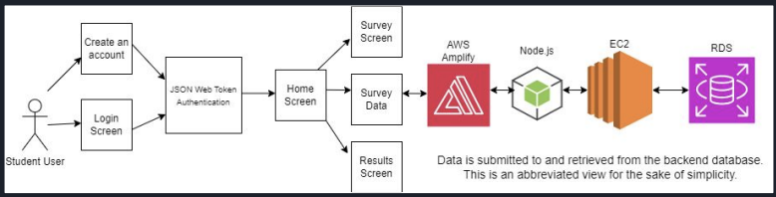
Previous team's progress - Architecture
Frontend
Backend
Notes:
Isabelle:
Frontend:
For the front end logic:
THE PREVIOUS TEAM:
student can login or create an account
Authentication was handled using JSON web token
Upon validation, user is taken to the home screen
They will then have the option to either take the survey or view their survey results
Backend:
THE PREVIOUS TEAM:
Frontend Integration: AWS Amplify connects the frontend of the web application to the backend
Backend: their backend is implemented using Node.js, which will handle server side logic and API endpoints
Hosting: The application backend is hosted on Amazon EC2, enabling project scalability when needed
Database: data is stored and managed in Amazon RDS

Slide 9
Previous team's progress - Functionality
Take the survey
Users can take the survey directly through the web application
View Survey Results
Displays survey results immediately after completing survey
Results represented as either a bubble chart or bar chart
Users can compare their current results to any past result
Export Results
Users can download their results as a PDF
PDF includes breakdown of each category the survey measures
Notes:
Max
Users can take the survey and are able to see their results immediately after completing the survey
The results are represented as a bubble chart or bar chart and you can compare with their past results
Finally you can export these results to a PDF

Slide 10
Requirements from Previous Design
Functional Requirements:
Allow participants to take survey and view their results
Allow researchers to download data
Enable survey modification for Program coordinators
Nonfunctional Requirements:
Use GitHub for version control
Deploy to AWS
Notes:
Max
What we gathered from the previous design is that (read slide) and that we would also need A GitHub for version control and AWS for database/cloud functionality

Slide 11
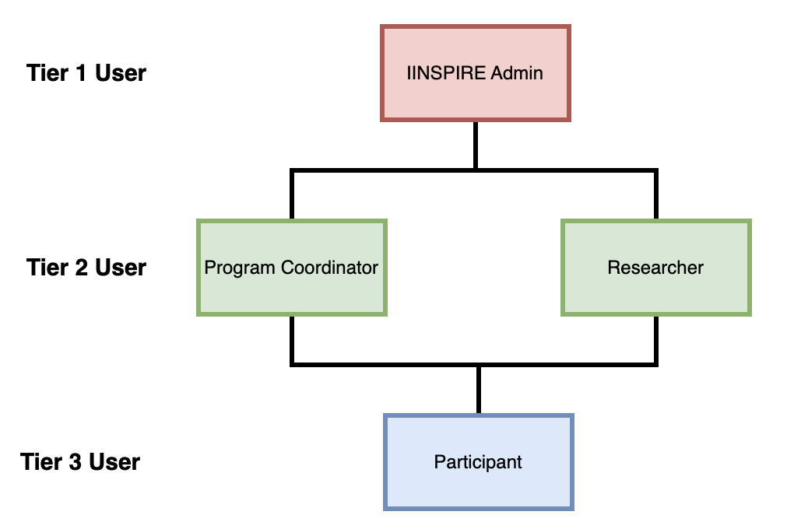
User Requirements
Tier 1 User
IINSPIRE Admin
Tier 2 User
Program Coordinator
Researcher
Tier 3 User
Participant (Student)
Notes:
Nick: This is the break down of the different user roles within the IINSPIRE system and their specific requirements. This structure ensures that each group has access to the tools and information they need to fulfill their responsibilities effectively.

Slide 12
Tier 1 User IINSPIRE Admin
User Management
Access to manage user permissions and activity
Grant super user roles to the other users
Data Access and Security
Access to real-time survey results and should ensure that surveys comply with security regulations
Updates
Ability to communicate with all users or specific groups about changes with surveys
Access to patching/updating the web application
Notes:
Nick:
User Management
One of the primary duties of an IINSPIRE Admin is managing users across the platform. They have access to oversee user activity and permissions, ensuring everyone has the right access level for their role.
Data Access and Security
Another crucial responsibility is managing data access and maintaining security standards.
IINSPIRE Admins can access real-time survey results, enabling them to monitor program engagement and outcomes.
Communication and Updates
Communication is a key aspect of the admin role. They can send updates to all users or specific groups, ensuring transparency about any changes to surveys or the platform.

Slide 13


Tier 2 User Researcher and Program Coordinator
Researcher:
Export data to CSV file
Sort user data by demographic
Search user results by email
View holistic survey results
Program Coordinator:
Create, edit and delete surveys
Assign surveys to students
Share and download data
View survey results
Notes:
Nick: Tier 2 Users, who serve as a bridge between system administration and student participants.
This tier includes two critical roles—the Researcher and the Program Coordinator
Researcher should be able to:
Export data to CSV file to use elsewhere
Sort user data by demographic to see any possible trends
Search user results by email
View holistic survey results
Program Coordinator should be able to:
Create, edit and delete surveys
Assign surveys to students
Share and download data
View survey results

Slide 14
Tier 3 User Participant/Student
Easy access and sign/in process to take surveys
Surveys need to be simple yet thought-provoking and engaging
UI/UX needs to be responsive, smooth, and visually appealing
Integration for mobile devices for ease-of-use
Notes:
Nick: Tier 3 User Participant/ student
Easy Access and Sign-In Process
"For students, simplicity is key.
The platform ensures an effortless sign-in process, minimizing barriers to participation.
Surveys need to be simple yet thought-provoking and engaging
In order to achieve this, UI/UX needs to be responsive, smooth, and visually appealing
We also want Integration for mobile devices for ease-of-use on all platforms that a student might use

Slide 15
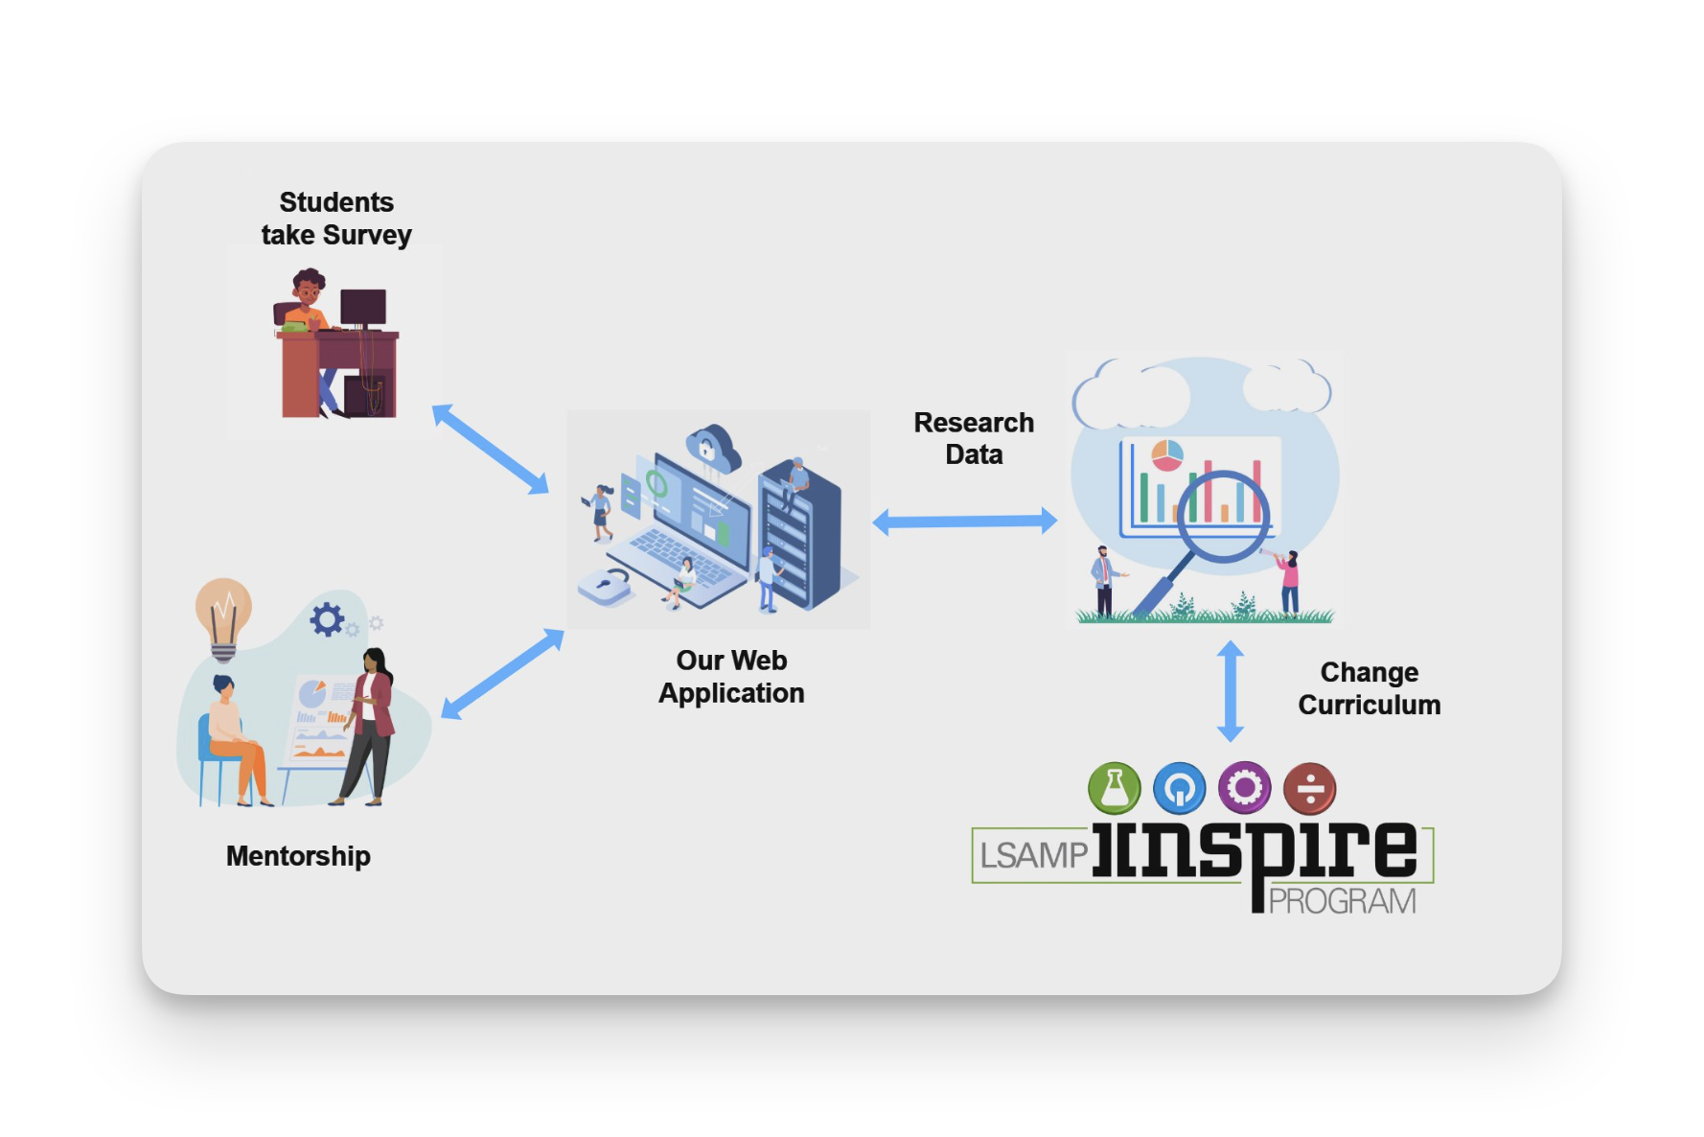
Project Vision
Notes:
Charlie
What is the vision for our project?
Our main focus is the idea of mentorship. We want our system to support meetings between students and Inspire Administrators by providing a visual graphic they can discuss.
It is very important that students not only take the survey but use the data themselves to learn about their own abilities.
We also want to provide easy data export for the University of Iowa Research team to use. This data can be used to change the curriculum of programs to better meet student needs or in the future could even
Showcase why such a program needs funding.
We want this whole system and how it interacts with different users to be portable between different programs. If another University wants to start an Inspire similar program we want our system to meet their needs.

Slide 16
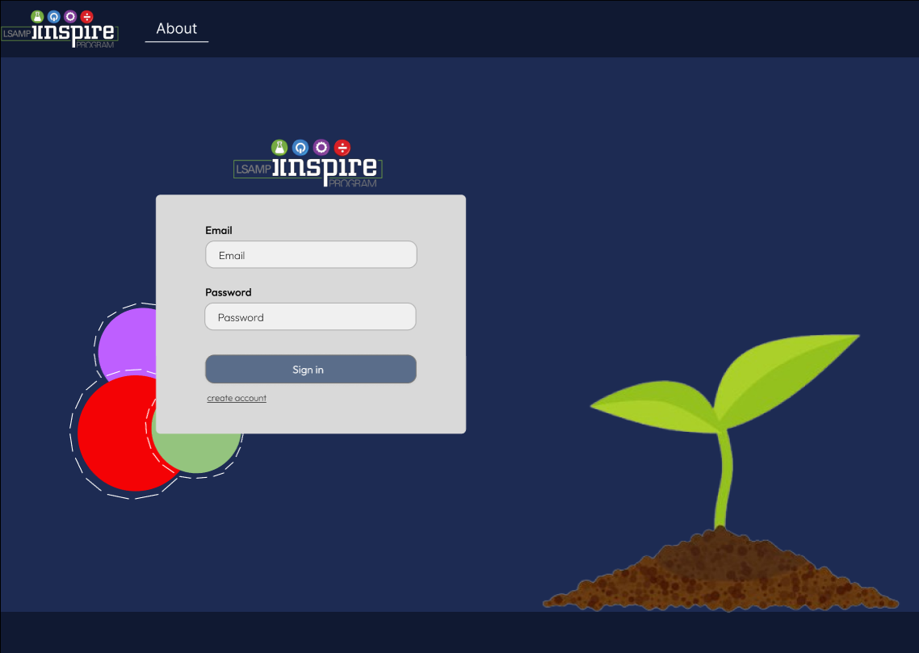
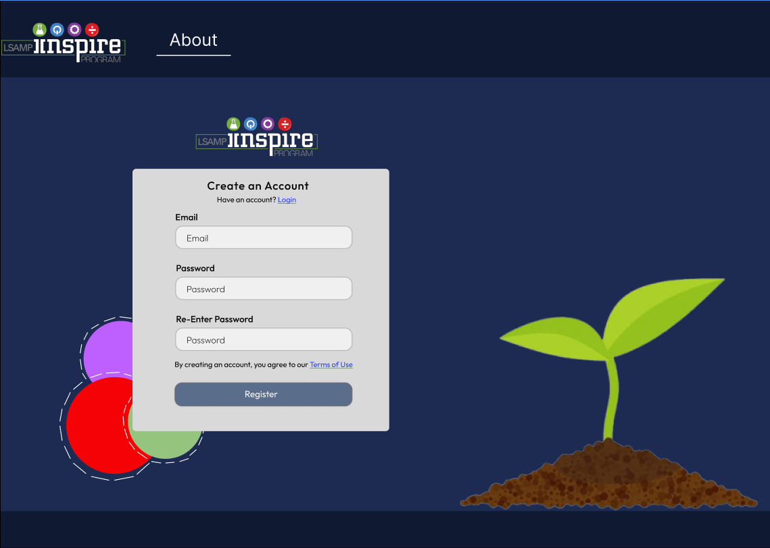
Frontend Design Log in and Sign Up
Notes:
Isabelle: Our landing page will be a login/sign up page that allows users to create an account using an existing email account

Slide 17
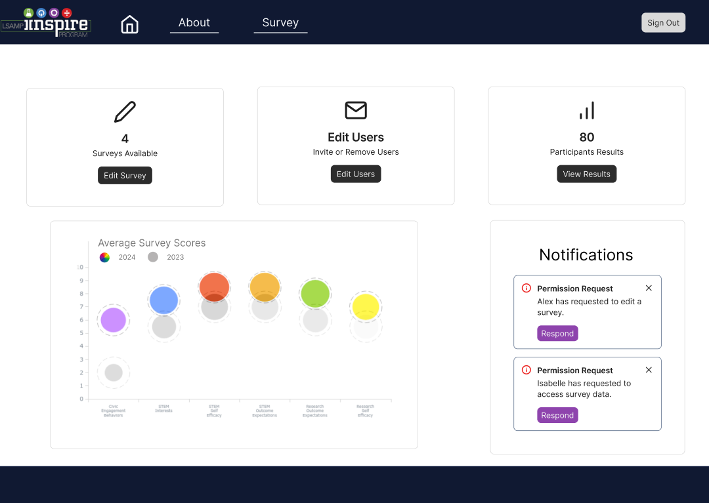
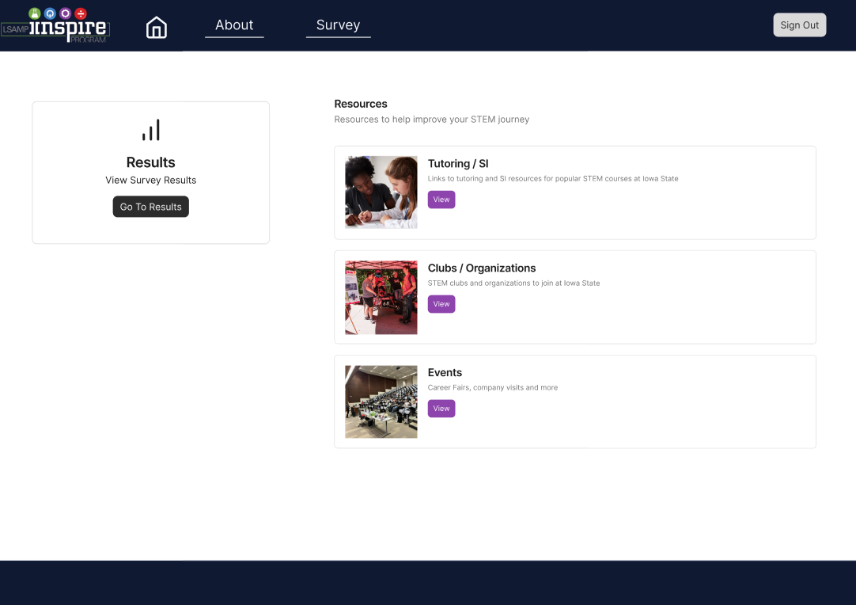
Frontend Design Admin and Student/Participant Dashboard
Notes:
Isabelle- on the left is the admin dashboard. It allows administrators to manage surveys effectively, including creating, editing, and deleting surveys, inviting students to participate, and reviewing the results of all participants.
On the right is the student dashboard. It enables students to access and analyze their survey results, compare their most recent results to previous ones, and access tailored academic and social resources specific to their university

Slide 18
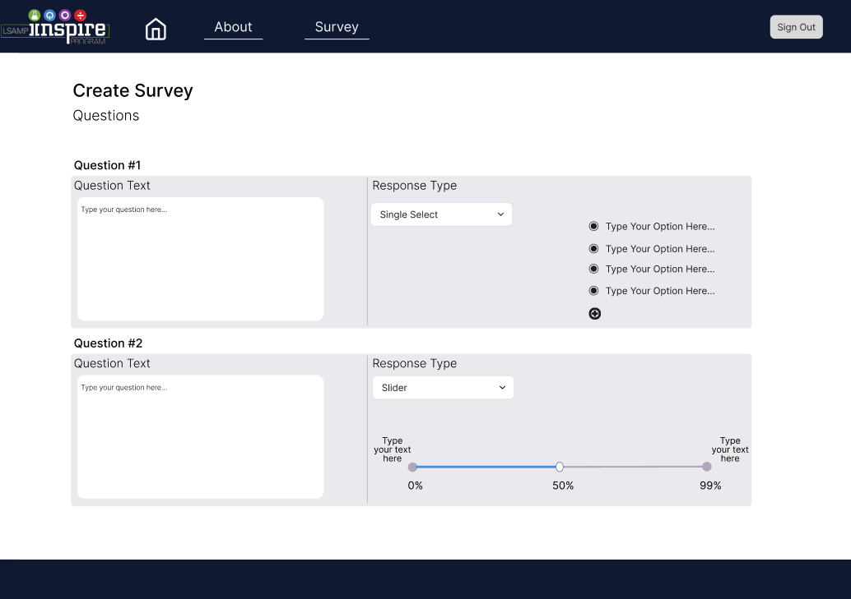
Frontend Design Create/Edit Survey Questions
Notes:
Max
This is our view to create or edit your survey, here you can change the text of each question, the response type like a single select, multi-select, text, slider, or range input, and the response text

Slide 19
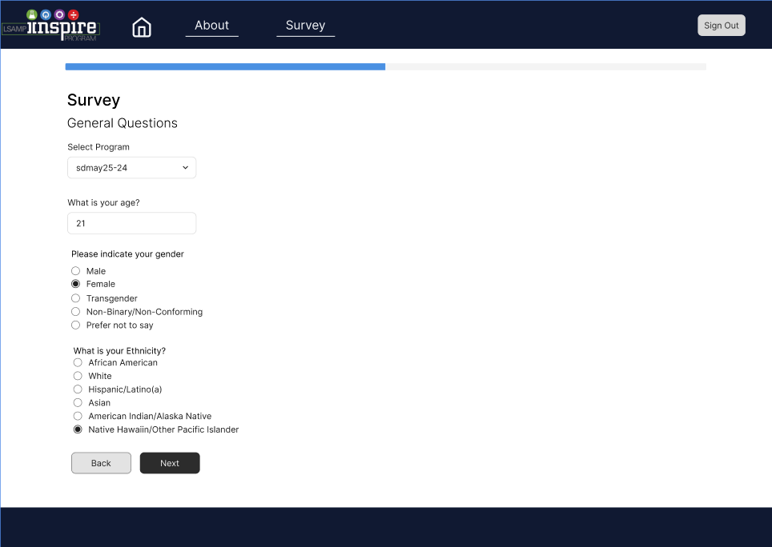
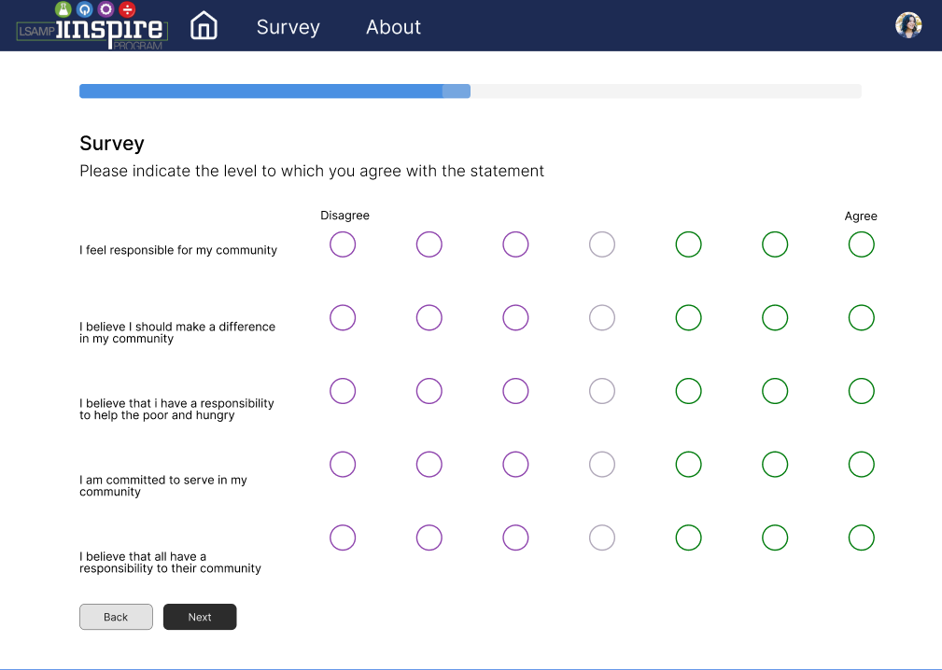
Frontend Design New Survey Designs
Notes:
Max
For the survey redesign
After meeting with individuals from the University of Iowa and CSSM and listening to their suggestions to make life easier for the people taking the survey, we made many improvements to the UI including: Added a progress bar on the top of the page to see how far along in the survey you are,
Different response types where appropriate such as a dropdown to select which program you're in or a number input for the age,
A back button to go back to a previous question
And made the disagree/agree inputs a lot easier to read and select your answer.

Slide 20
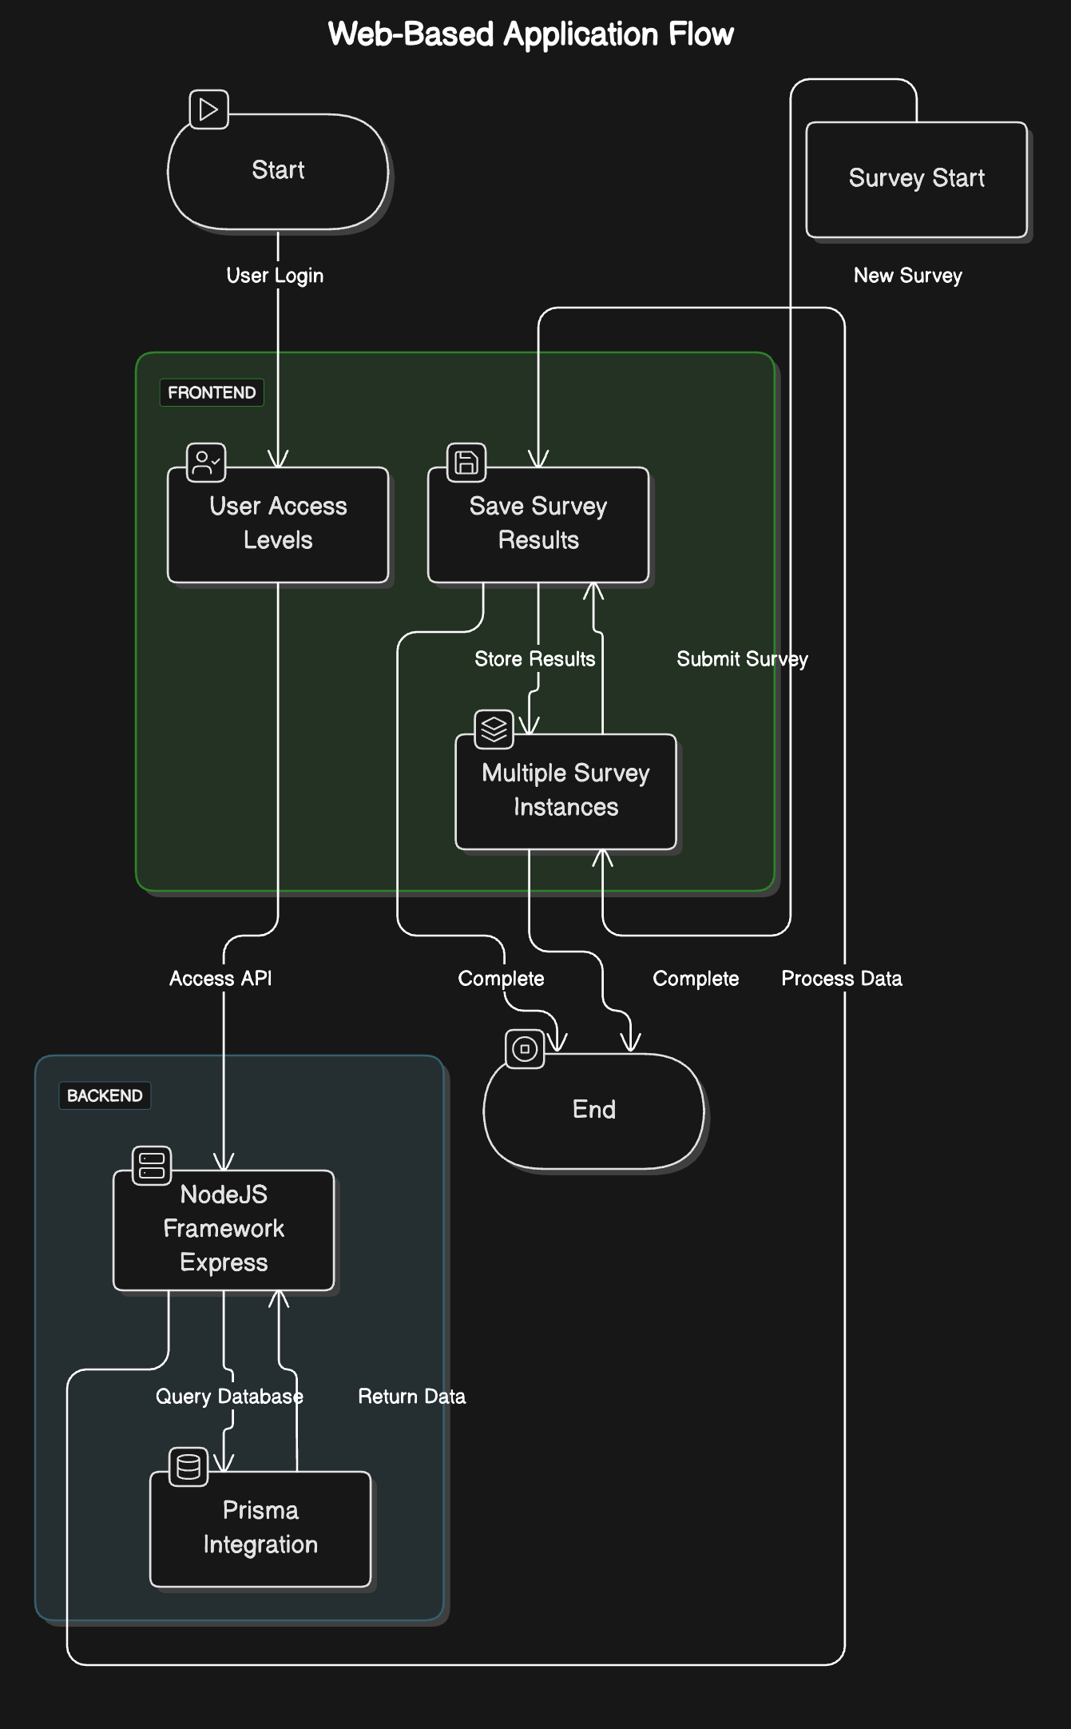
Backend Design
More Complex Design requires collecting more data
Integrate technologies to reduce complexity
Prisma
Simplifies How we interact with our Database
NodeJS Framework Express
Handles routing of our request
Swagger
Automates creating API Endpoints
Automatically generate Documentation
Notes:
Charlie
As our design has gotten more complex the amount of data we need to collect has grown as well. To support this increase in data we want to integrate different technologies to reduce the complexity and increase the efficiency of our development.
The first technology is Prisma, an Object Relational Mapping tool which means it gives us a Graphical User Interface to interact with our database.
The next technology is Express Framework, which handles the routing of all API requests coming from our client applications.
Lastly Swagger, is a tool for developing REST APIs. It can Automatically generate code for API endpoints and will help us automatically generate documentation for Request Handlers and Error Codes.

Slide 21
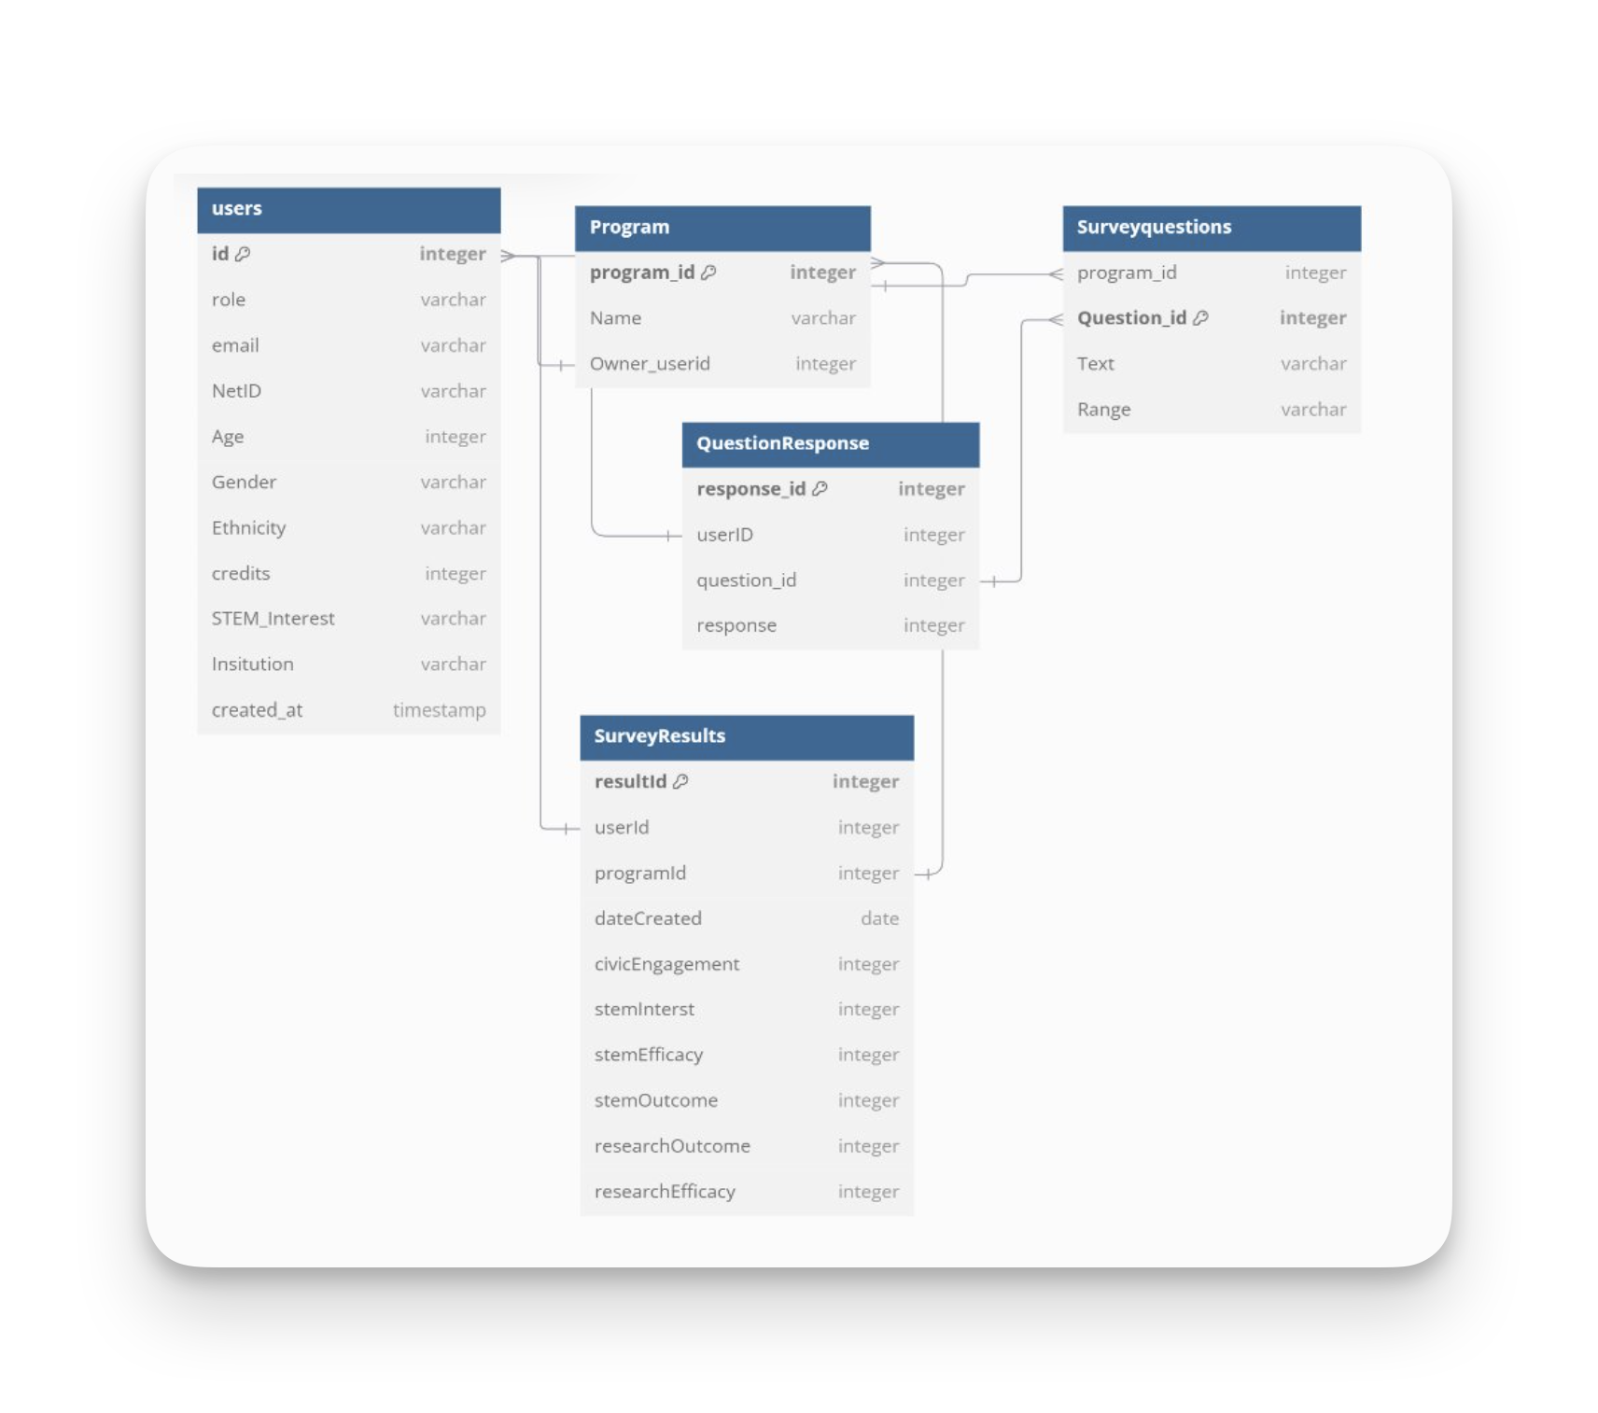
Database Redesign
Refined previous Database design
More Saved data for researchers
User Access Levels
Save multiple survey results for a single user
Multiple survey instances
Notes:
Charlie
We had to redesign our database to support all of the additional functionalities we want to include.
Some of the highlights of Database Changes we made.
More saved data for the researchers,
Hold data for each individual question response for every individual student
User Access Levels
With the 3 user levels we have we wanted to create user role types so our backend know what access users should have.
Save Multiple survey results
In order to showcase student growth we need to be able to hold the data of multiple survey results for every student
Multiple survey instances
Need to hold the data for different surveys with different questions, this supports the portability between programs.

Slide 22
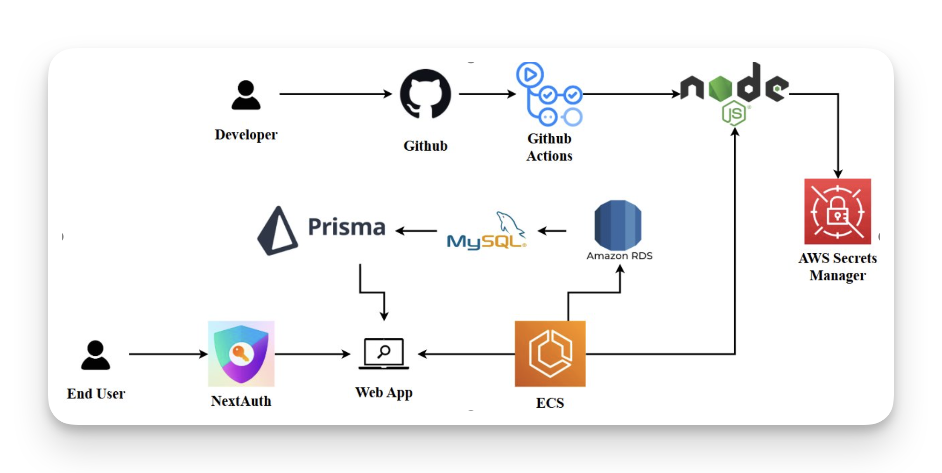
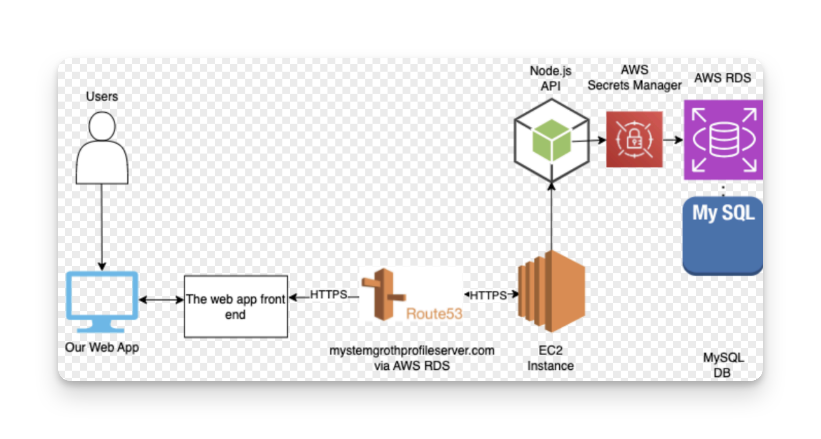
Cloud/Infra Re-Design
New
Cloud Re-design:
Replaces existing infrastructure, data will be migrated
Deployed and managed from a university owned Github
Goals:
Operational Goals: Increase Security, Support long-term development, Lower Costs
User Experience Goals: Reduce User Friction, Simplify Development Process, Making data more accessible
Major Changes:
EC2 containers replaced with ECS
3rd party login through Next Auth
Prisma Integration
CI/CD through GitHub Actions
Old
Notes:
Cloud Redesign Built off last years cloud design Will completely replace V1 infrastructure in January after a Dr. Rover demo's
All existing survey data will be maintined
Worked with ETG to setup a university owned github, future iterations will work from
Goals:
Operational goals:
User Experience: improving the experience for anyone who interacts with the project: Developers, Participants, Researchers
Data acecssible:
Major Changes:
can be seen in the diagram
ECS: scalable contianer service
Prisma: accessing data through apis
CI/CD: largest addition

Slide 23
Cloud Design-User Perspective
Average User:
Simplified Login: Allows users to login with Google, Outlook, etc..
Automated Scaling: App will scales based on demand reducing slowdown during heigh demand times
Admins:
Reduced Cost: ECS charges based on load, reducing wasted costs when not in high demand
Developer:
Faster Development: CI/CD automates testing and deployment for new features
Simple Infrastructure: Re-design allows for hands off management and data access
Improved Data Access: Prisma simplifies database access, giving with faster and more reliable access to data.
Notes:
Lets look on how it this will affect everyone who interacts with the app on a more quantifible level Average User:
Simplified Login: Instead of creating an account, users can log in through known providers like Google or Outlook.
Automated Scaling: Resources scale up or down based on user demand, ensuring the website remains fast and responsive.
Admins:
Reduced Cost: Compared to EC2, ECS only charges based on demand, avoiding over-provisioning resources (e.g., provisioning for 100 users when only 10 are active).
Data Access: Prisma simplifies data access, offering greater flexibility and more reliable database operations : Known Issue in V1: Minor reliability issues identified, under review for resolution.
Will be able to implement access heirarchy to resources
Developer:
New Infrastructure: The redesigned system requires minimal maintenance once set up, reducing overall complexity and allowing developers to focus on feature development.
Due to the flexible design future developers will not have to tinker with much when expanding the scope.
CI/CD Pipelines: When new features are creating developers make a pull requests into the main app then which layer of automated testing will run. After it is accepted our CI/CD pipelines will automatically deploy the new code to our live production app.
This adds a layer of testing
Removes need to manually redeploy app

Slide 24
Project Schedule and Milestones
Phase 1
Establish HTTP Requests with Postman
Phase 2
Connect Database/Complete Landing Page
Phase 3
Survey Screens/SQL Querys
Demo 2
Phase 4
Settings/Feedback
Phase 5
Final Touches
Demo 3
Demo1
Security
Notes:
Landon
We chose to implement the agile process using Jira for managing our project throughout the semester. With this we decided to break our project down into 5 phases including 3 demos. Each phase is expected to be around a month long. We will also have weekly meeting every week with our advisor and team seperatly.
Additionally we will have a sprint with new commitments every 2 weeks. Each phase is asking for a chunk of work to be done in that time period so each team member will report what piece of the phase task they are working on during the beginning of each sprint and try to have it done by the end of then sprint.
Finally we will have 3 demos to keep ourself accountable for our work, these will occur around every month and a half. These act as a benchmark for where we want the project progress to be at that time.

Slide 25
Vision for Final Project
Enhanced User Experience:
Redesign survey to mitigate survey fatigue
Improve website design to be more visually appealing and intuitive
Responsive Design:
Develop our web application to be optimized for both desktop and mobile devices for greater accessibility
Portability:
Create our system to be easily adapted for use across multiple universities
Data-Driven Advocacy:
Use survey results to advocate for program funding and demonstrate impact
Notes:
Landon
The students who took the survey from the LSAMP program told us that the overall user experience was not very good. So we want to focus on,
Enhanced User Experience:
Our goal is to create a better user experience by addressing survey fatigue. This means redesigning the survey to make it less repetitive and more engaging for participants. Alongside this, we aim to improve the overall website design, making it visually appealing and easy to navigate.
Responsive Design:
We are looking to have our web application to be fully optimized for use on both desktop and mobile devices. This ensures users can easily access the survey and results, regardless of the device they are using.
Portability:
A key part of our vision is scalability. We want our system to be portable, so it can be adapted and implemented by other universities participating in the LSAMP program. This way, our tool can have a broader impact beyond just Iowa State and the University of Iowa.
Data-Driven Advocacy:
Finally, we aim to make the survey results actionable. By automating survey result visualizations, we can use the data to advocate for program funding and demonstrate the impact of STEM on students.
This vision shows our commitment to recreating a portable, impactful, and user-friendly survey system for both students and administrators.

Slide 26
Questions?

